Slide 1
WEB SCRAPING – TO PREDICT MOVIE SUCCESS
TEAM MEMBERS
JUI PATEL
TANVI ANAND

Slide 2
PROBLEM STATEMENT
Scrape movie review, comments & rating data through sites. (Make sure the website policy allows you to scrape data/content from their sites). Use the scraped data to predict the movies that will be Blockbusters.
TECHNOLOGY USED : PYTHON

Slide 3
FACTORS
Directors
Cast
Genre
Year of Release
Ratings
Votes
Worldwide Gross

Slide 4
WEB SCRAPING
WEBSITE USED : https://www.imdb.com/list/ls041664436/
https://www.imdb.com/list/ls021545925/
https://www.imdb.com/list/ls066672023/
LIBRARIES USED : BeautifulSoup, pandas, requests
EXPORT the metadata to csv file .
REFERENCE : www.Dataquest.io

Slide 5
ALGORITHMS USED FOR COMPARISON
Logistic_Regression
Adaboost
Kneighbor
NBC
SVM

Slide 6
ADABOOST
Each instance in the training dataset is weighted. The initial weight is set to:
weight(xi) = 1/n
Where xi is the i’th training instance and n is the number of training instances.
A weak classifier is prepared on the training data using the weighted samples. Only binary classification problems are supported. So each decision stump makes one decision on one input variable. And outputs a +1.0 or -1.0 value for the first or second class value.
The misclassification rate is calculated for the trained model. Traditionally, this is calculated as:
error = (correct – N) / N
Where error is the misclassification rate. While correct is the number of training instance predicted by the model. And N is the total number of training instances.

Slide 7
Predictions are made by calculating the weighted average of the weak classifiers.
For a new input instance, each weak learner calculates a predicted value as either +1.0 or -1.0. The predicted values are weighted by each weak learners stage value. The prediction for the ensemble model is taken as a sum of the weighted predictions. If the sum is positive, then the first class is predicted, if negative the second class is predicted.

Slide 8
SVM - Support Vector Machine
SVM stands for Support Vector Machine. It is a machine learning approach used for classification and regression analysis. It depends on supervised learning models and trained by learning algorithms. They analyze the large amount of data to identify patterns from them.
We can use Linear SVM for finding the largest and smallest margin hyperplane that divides the training data D, and a set of n points. If the training data is separable, then select two hyperplanes in a way that they separate the data. There are no points between them and the distance between them known as margin. It can maximize the margin. You can calculate the distance between these 2 hyperplanes by applying simple geometry. You can measure distance directly by 2/||a|| quantity. To increase the distance you have to reduce||a||.

Slide 9
Primal Form – Primal form helps to better solve the linear SVM problem. It uses standard quadratic programming techniques and programs.
Dual Form – You can use the dual form to write classification rules as an unconstrained system. By doing this you get hyperplane with greatest possible margin. In such cases, represent classification process as a function of support vector machines. A subset of training data lies on
Biased and Unbiased Hyperplanes Represent data points and hyperplanes in the same coordinate system. Divide hyperplanes into 2 types on the basis of their coordinates as:
Biased hyperplanes – Hyperplanes that do not pass through the origin of the coordinate system.
Unbiased hyperplanes – Those that pass through the origin of the coordinate system.

Slide 10
KNEIGHBOR
As we saw above, KNN can be used for both classification and regression problems. The algorithm uses ‘feature similarity’ to predict values of any new data points. This means that the new point is assigned a value based on how closely it resembles the points in the training set.
ALGORITHM
Let m be the number of training data samples. Let p be an unknown point.
Store the training samples in an array of data points arr[]. This means each element of this array represents a tuple (x, y).
for i=0 to m:
Calculate Euclidean distance d(arr[i] , p).
Make set S of K smallest distances obtained. Each of these distances correspond to an already classified data point
Return the majority label among S.

Slide 11
LOGISTIC REGRESSION
Linear regression algorithms are used to predict/forecast values but logistic regression is used for classification tasks
Making predictions with a logistic regression model is as simple as plugging in numbers into the logistic regression equation and calculating a result.
Let’s make this concrete with a specific example.
Let’s say we have a model that can predict whether a person is male or female based on their height (completely fictitious). Given a height of 150cm is the person male or female.
We have learned the coefficients of b0 = -100 and b1 = 0.6. Using the equation above we can calculate the probability of male given a height of 150cm or more formally P(male|height=150). We will use EXP() for e, because that is what you can use if you type this example into your spreadsheet:

Slide 12
y = e^(b0 + b1*X) / (1 + e^(b0 + b1*X))
y = exp(-100 + 0.6*150) / (1 + EXP(-100 + 0.6*X))
y = 0.0000453978687
Or a probability of near zero that the person is a male.
In practice we can use the probabilities directly. Because this is classification and we want a crisp answer, we can snap the probabilities to a binary class value, for example:
0 if p(male) < 0.5
1 if p(male) >= 0.5

Slide 13
NBC
Naive Bayes is a simple technique for constructing classifiers: models that assign class labels to problem instances, represented as vectors of feature values, where the class labels are drawn from some finite set. There is not a single algorithm for training such classifiers, but a family of algorithms based on a common principle: all naive Bayes classifiers assume that the value of a particular feature is independent of the value of any other feature, given the class variable. For example, a fruit may be considered to be an apple if it is red, round, and about 10 cm in diameter. A naive Bayes classifier considers each of these features to contribute independently to the probability that this fruit is an apple, regardless of any possible correlations between the color, roundness, and diameter features.

Slide 14
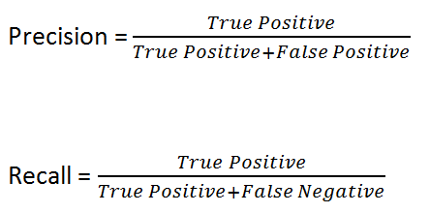
RESULTS
To evaluate any technique we look at 3 important aspects on the basis of confusion matrix:
1. Accuracy
2. Precision
3. Recall

Slide 15
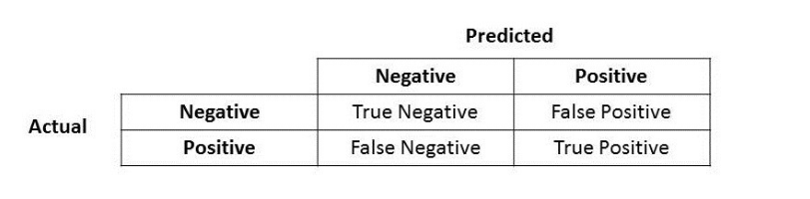
CONFUSION MATRIX

